Slide 1
Effect of Exclamation Points on Rental Market Outcomes Chris Mcpherson | Leslie Teo | Nicholas Chen | Paul Varjan w241 Final Project

Slide 2
Research Question
Do exclamation points signal sincerity and friendliness in an email to a prospective landlord? Operationalized, does including an exclamation point (or more) make you more likely to receive a positive response when applying to an apartment?

Slide 3
Experimental Design
Multi-factor audit study
Two treatment levels (! and !!!!)
Gender variation
Drafted stock emails for each treatment level, varied only punctuation
Record response rates to each treatment level

Slide 4
Data Collection
Scraped apartment listings from Craigslist in four cities
First 100 results of search queries for 1 and 2 bedroom apartments in $500 price buckets from $1,000 per month to $4,000 per month
Randomly selected 180 listings from each city
Randomly assigned 30 selected listings from each city to each treatment / control group

Slide 5
Data Issues
Multiple emails sent to same listing agents
All emails not sent at same time of day / week
Multiple listings for the same property

Slide 6
Analysis

Slide 7
Data Validation
Administrative Errors
Verified the number of treatments and outcomes recorded
Checked for differences across treatments – important due to our multifactor design
Measured for covariate imbalance
Validity of randomization

Slide 8
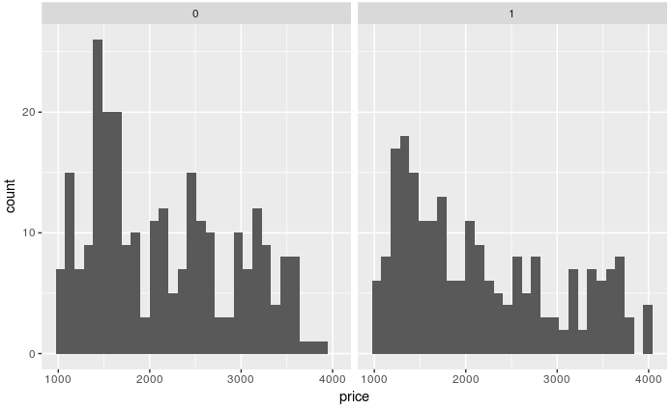
Data Profiling

Slide 9
Outcomes

Slide 10
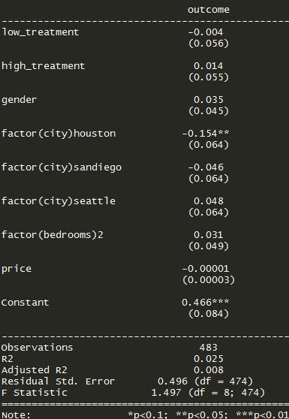
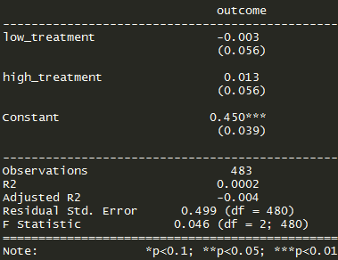
ATE

Slide 11
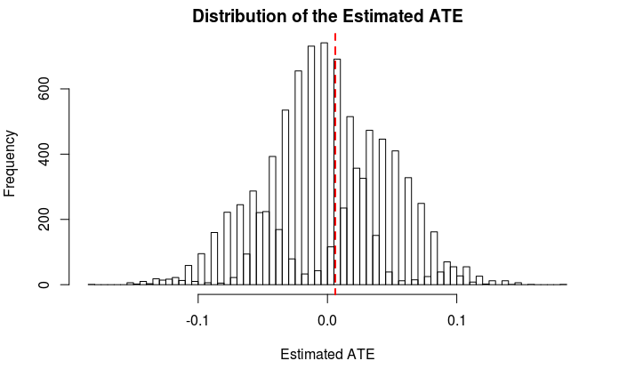
Randomization Inference

Slide 12
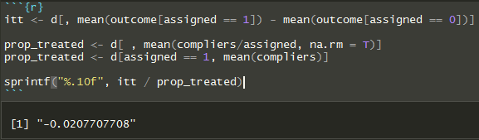
CACE (One-sided Noncompliance)

Slide 13
Conclusions and Next Steps

Slide 14
Discussion of Results
No significant effects of gender or exclamation point treatment on response rates.
Perhaps due to high prevalence of professional management companies
Management companies have incentive to respond no matter what
We also observed same individual listing agents receiving multiple emails

Slide 15
Next Steps
Could have been appropriate use-case for adaptive sampling where we may have wanted to collect additional data on private party postings
Try the same experiment in a different market without so many professionally managed listings (e.g. cars for sale by owner)
Determine whether postings are by same individual or for same property

